Slide 1
Tutorial Machine Learning in Solid Mechanics
Task 2: Hyperelasticity
Xin Xiong ,Huasen Luo
December 17, 2024

Slide 2
Agenda
1
Data preparation
2
Neural network model
3
Physics-augmented neural network model
4
Concentric sampled deformation gradients
5
Homogenized cubic lattice metamaterials

Slide 3
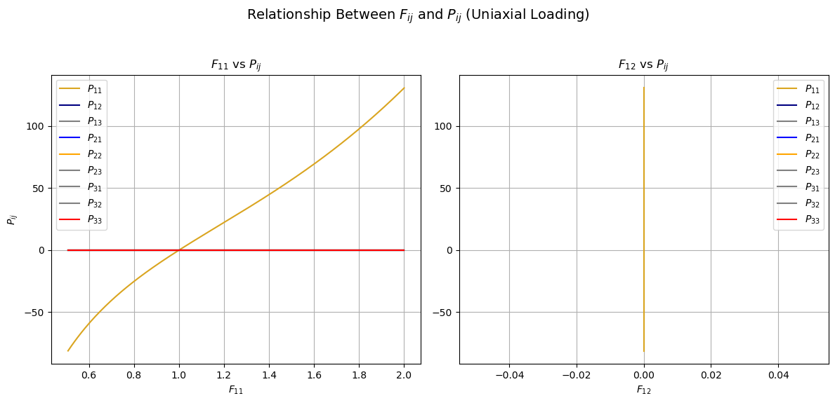
1.1 Data import
Notes:
At the beginning, we imported three key components of the dataset:
Deformation gradient F
First Piola-Kirchhoff stress P
Strain energy density W
We reshaped F into a matrix format for easier processing:
Visualized the different load paths, including biaxial loading, Pure shear loading, uniaxial loading
F11 leading to increases in P11

Slide 4
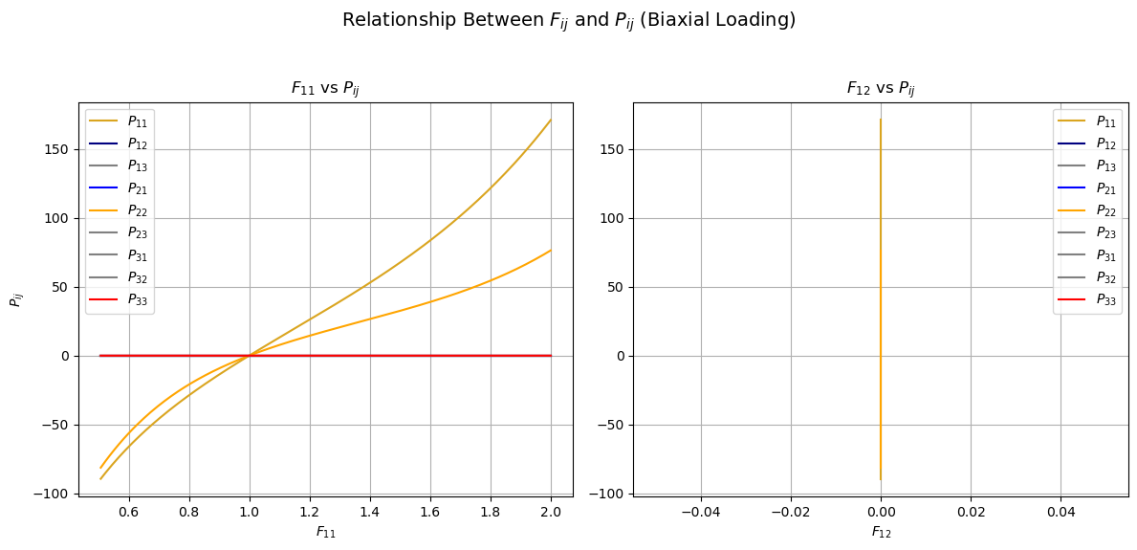
1.1 Data import
Notes:
F11, leading to corresponding increases in P11 and P22

Slide 5
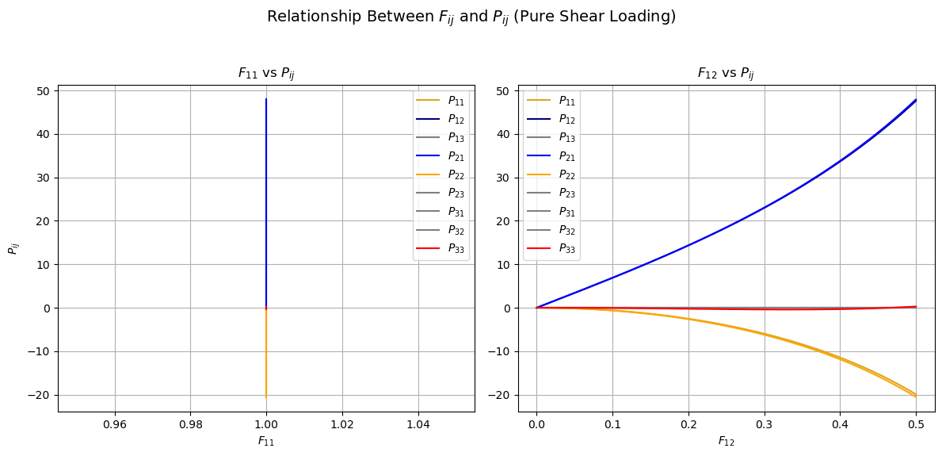
1.1 Data import
Notes:
F12 influences P12 and P21

Slide 6
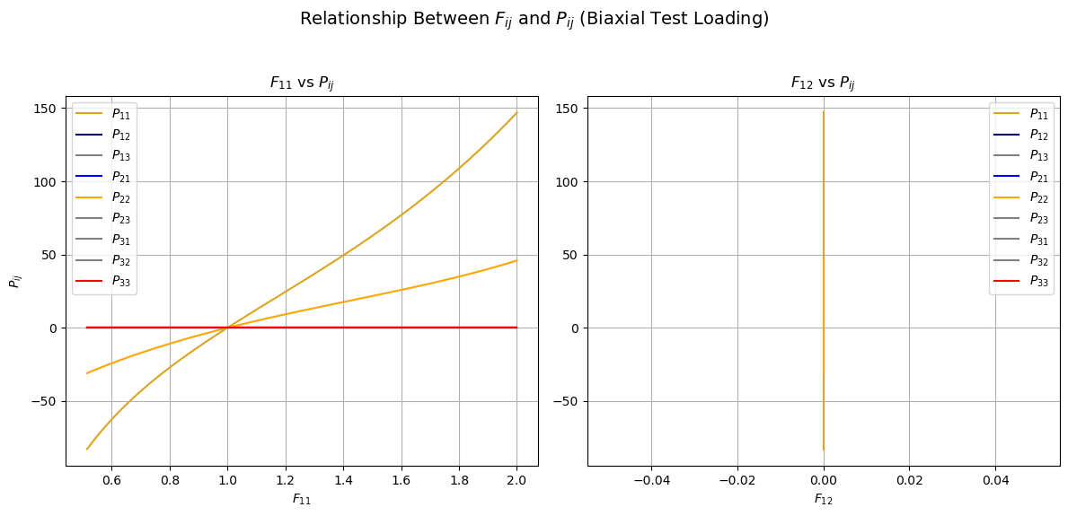
1.1 Data import

Slide 7
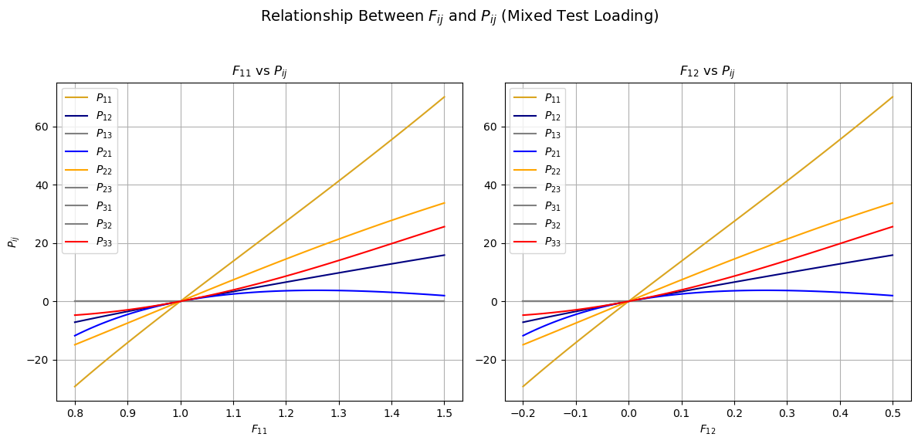
1.1 Data import
Notes:
The Mixed Test Load plots clearly show multiple stress components (P11,P12,P22,) responding simultaneously, which is a hallmark of combining

Slide 8
1.1 Data import
Conclusion
Biaxial load paths​
Mixed test load
Pure shear load paths​
Extrapolation dataset
Uniaxial load paths
Biax test load
Biaxial load paths​
Interpolation​ dataset
Notes:
whether the test cases involve interpolation or extrapolation:
Compare the ranges in the calibration and test datasets using the output of the compare_ranges
Interpolation occurs if the test dataset values lie within the ranges of the calibration dataset.
Extrapolation occurs if the test dataset values lie outside the ranges of the calibration dataset.

Slide 9
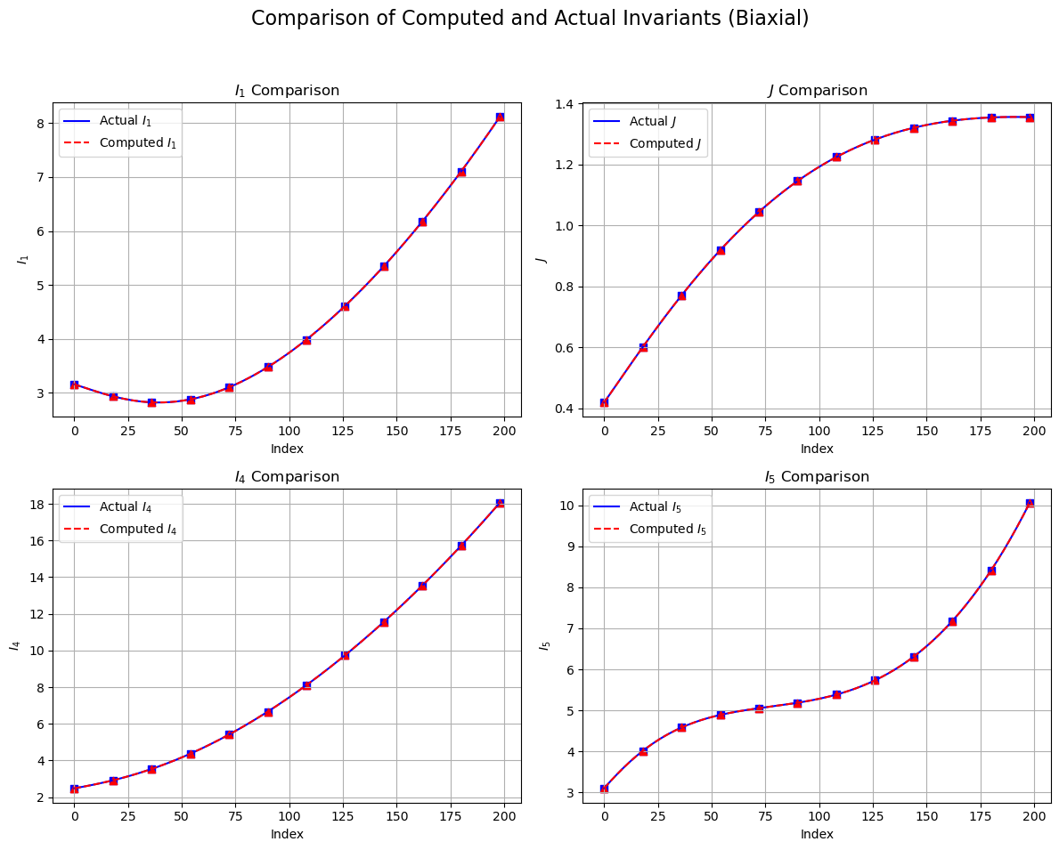
1.2 Analytical potential
Comparison of Computed and Actual Invariants(Biaxial):
It's the same.
Notes:
Next, we compare the computed invariants and the actual invariants under biaxial loading conditions to verify the accuracy of the implemented analytical hyperelastic potential.
The plots show the comparison for four invariants: I1 , J, I4 , and I5 .
For all invariants, the two curves match perfectly

Slide 10
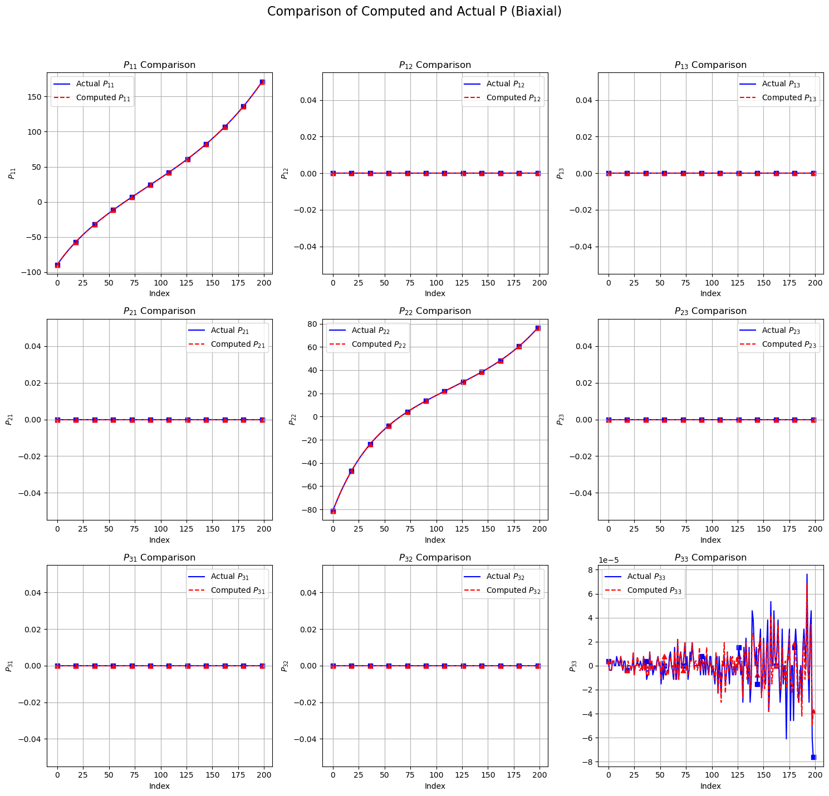
1.2 Analytical potential
Comparison of Computed and actual P (Biaxial):
It's the same.
Notes:
we compare the computed and actual stress components Pij under the biaxial loading conditions
Small numerical noise can be observed in P33 , but the overall results remain consistent.
It confirms that the stress computation aligns perfectly with reference data, validating the accuracy of the implemented hyperelastic potential and gradient calculation.

Slide 11
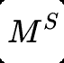
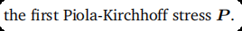
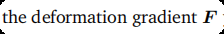
2.1 Model implementation
Introduction
input
output
Correspondence Between Physical/Mathematical Conditions and Model Structure：​
Satisfy the objectivity and material symmetry conditions.​
Notes:
we introduce the naïve neural network model Ms for predicting the stress P from the deformation gradient F.
The model satisfies two essential conditions: Objectivity, it ensures that the material response is invariant under rigid body rotations; Material symmetry, it refers to the invariance of the material response under specific symmetry transformations.

Slide 12
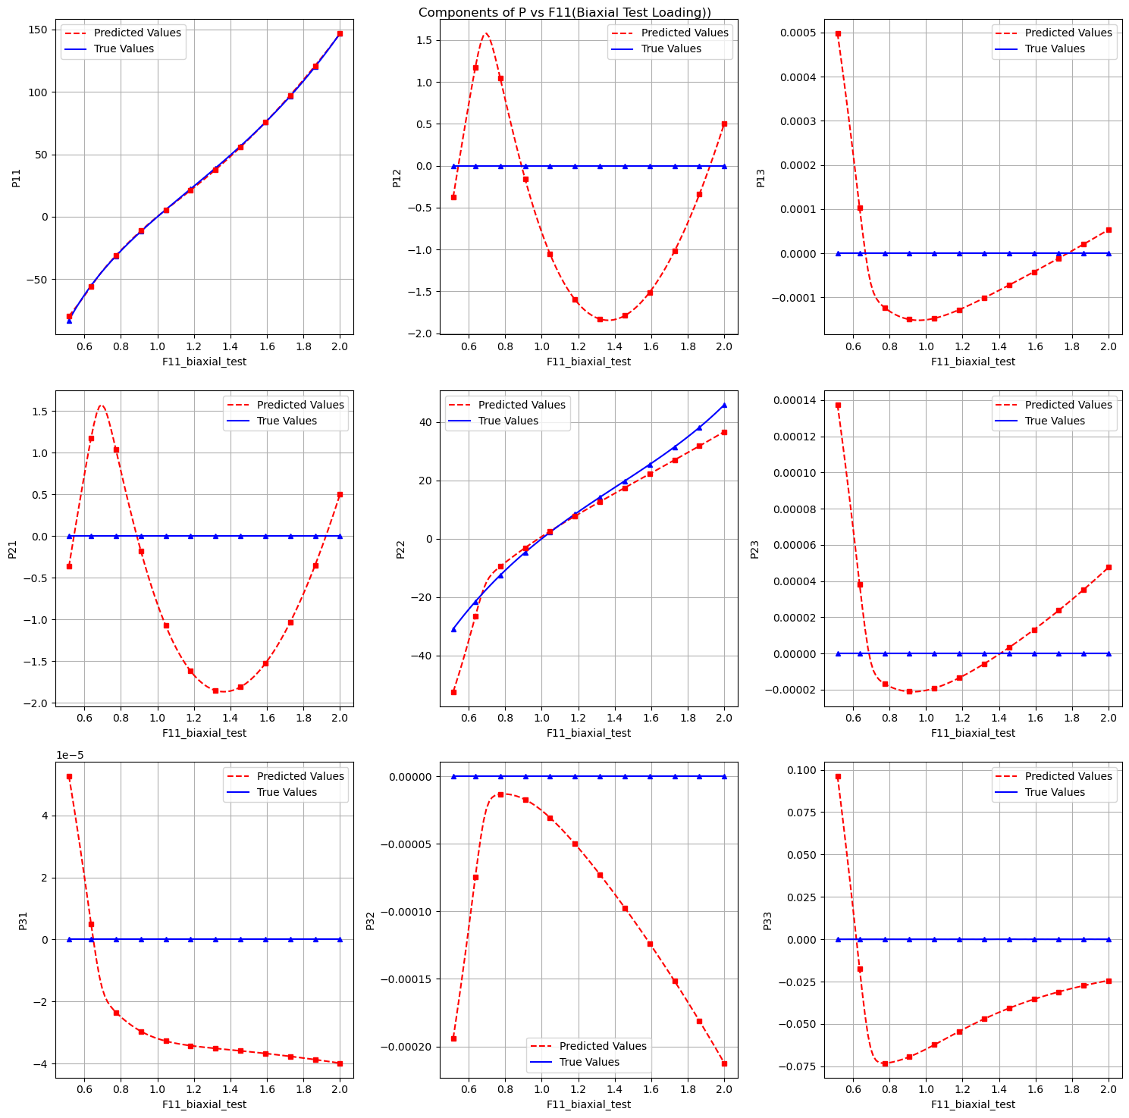
2.2 Model calibration
Components of P vs F11 (Biaxial Test Loading):
Notes:
Results of calibrating the naive neural network using the biaxial test dataset.

Slide 13
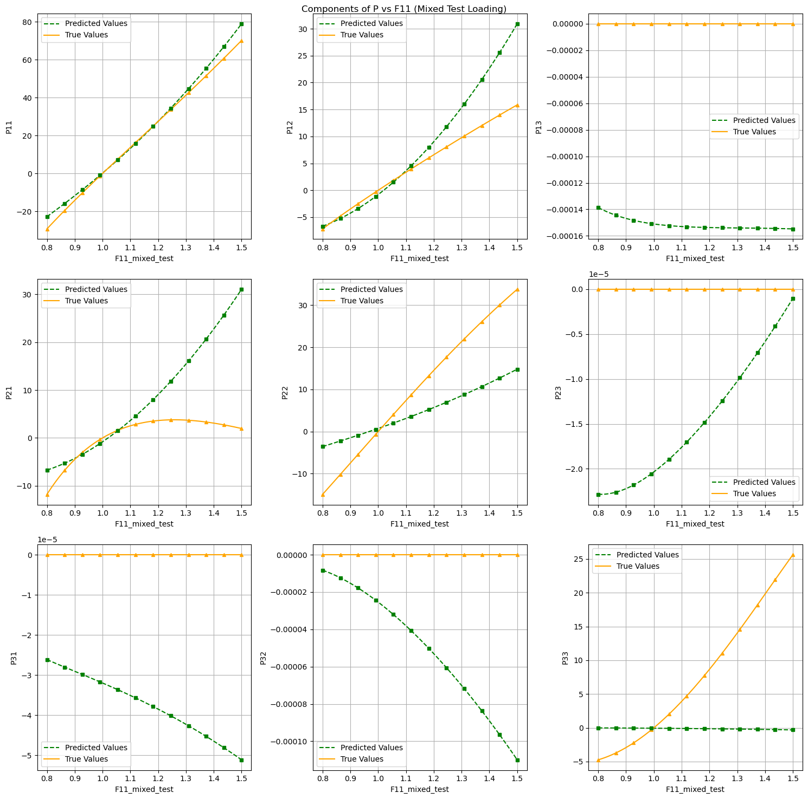
2.2 Model calibration
Components of P vs F11 (Mixed Test Loading):
Notes:
The performance drops, indicating that the model may overfit to the calibration data and fails to capture unseen loading patterns.

Slide 14
2.2 Model calibration
1. Is the model able to interpolate the calibration dataset?
Yes, the model demonstrates interpolation ability on the calibration dataset; however, the performance is not particularly outstanding.
2. Is the model able to predict the unseen load cases of the test dataset?
No, the model is not able to accurately predict the unseen load cases in the test dataset. This could be due to overfitting to the calibration data or the presence of more complex, unseen load patterns in the test set.
3. Does the model behave physically sensible?
The model's physical behavior is limited. While it satisfies objectivity due to the use of the right Cauchy-Green tensor C as input, it does not inherently satisfy other physical conditions such as material symmetry or polyconvexity.
Notes:
the model can interpolate the calibration dataset but with moderate performance.该模型可以对校准数据集进行插值，但性能适中。
it fails to predict unseen load cases accurately, likely due to overfitting or complex test patterns.对测试数据进行预测：该模型无法准确预测看不见的载荷工况，可能是由于过度拟合或复杂的测试模式。
it satisfies objectivity but lacks other physical conditions like material symmetry and polyconvexity.物理行为：该模型满足客观性，但缺乏其他物理条件，如材料对称性和多凸性。

Slide 15
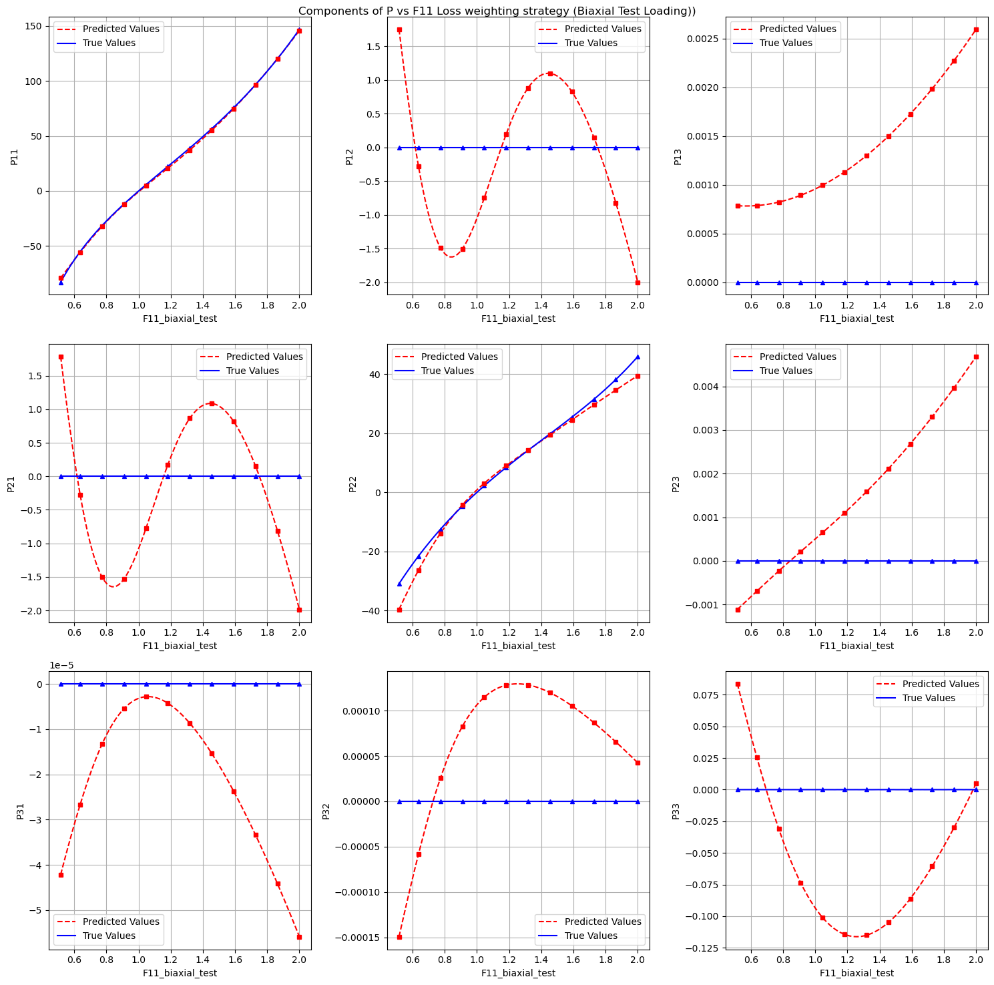
2.3 Loss weighting strategy
Components of P vs F11 Loss weighting strategy (Biaxial Test Loading):
Notes:
Plot: Stress component P versus deformation gradient F11 after applying loss weighting.
There are uneven contributions from different stress components during model training.

Slide 16
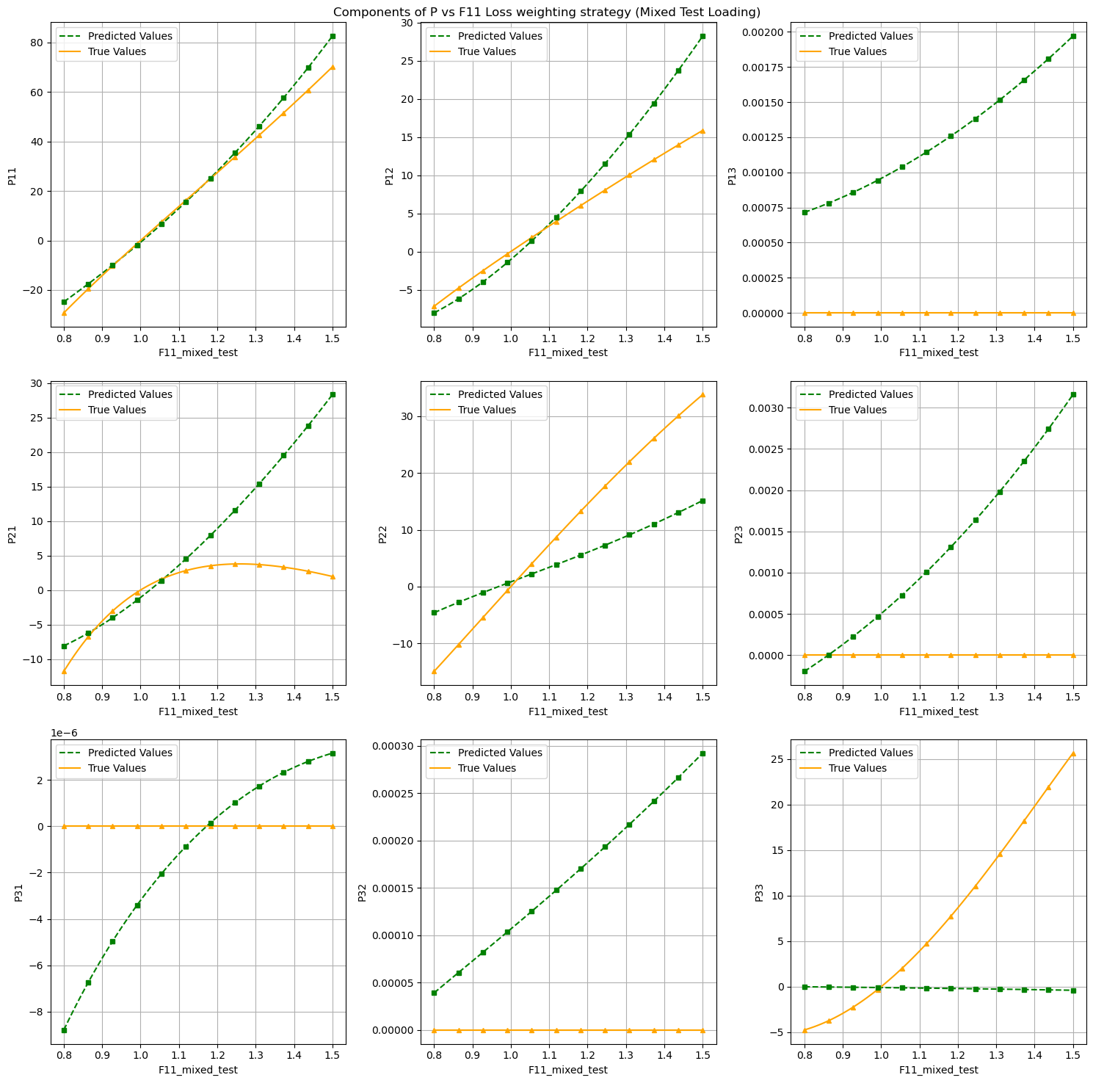
2.3 Loss weighting strategy
Components of P vs F11 Loss weighting strategy ((Mixed Test Loading):
Notes:
In the calibration dataset, load paths exhibit different orders of stress magnitudes.
For biaxial test loading, the improvement is evident but less dramatic because the data is relatively simple.
For mixed test loading, the strategy is crucial, as it enables the model to handle complex load paths with varying stress levels.

Slide 17
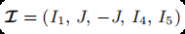

3.1 Model implementation
Introduction
input
output
optimizers
The weights for J in the first hidden layer are allowed to be positive or negative.
−J is introduced to ensure the polyconvexity constraint.
Correspondence Between Physical/Mathematical Conditions and Model Structure：
Satisfy the objectivity and material symmetry conditions.
Calculates P (stress) via gradients, ensuring the physical correctness of the model.
Notes:
In this Chapter we introduce a new model WI, we use invariants I as inputs, and use W as output. From now on means we only calibrate with energy.
So after we get the model, we can give F and P to optimize it. And we keep calculating P via gradients. Then it means we calibrate with both energy and stress
And also we can directly use P as output. Which means we only calibrate with P.
The most difference between this model and standard ICNN model is the first layer. For the standard ICNN the first layer must directly enforce convexity.

Slide 18
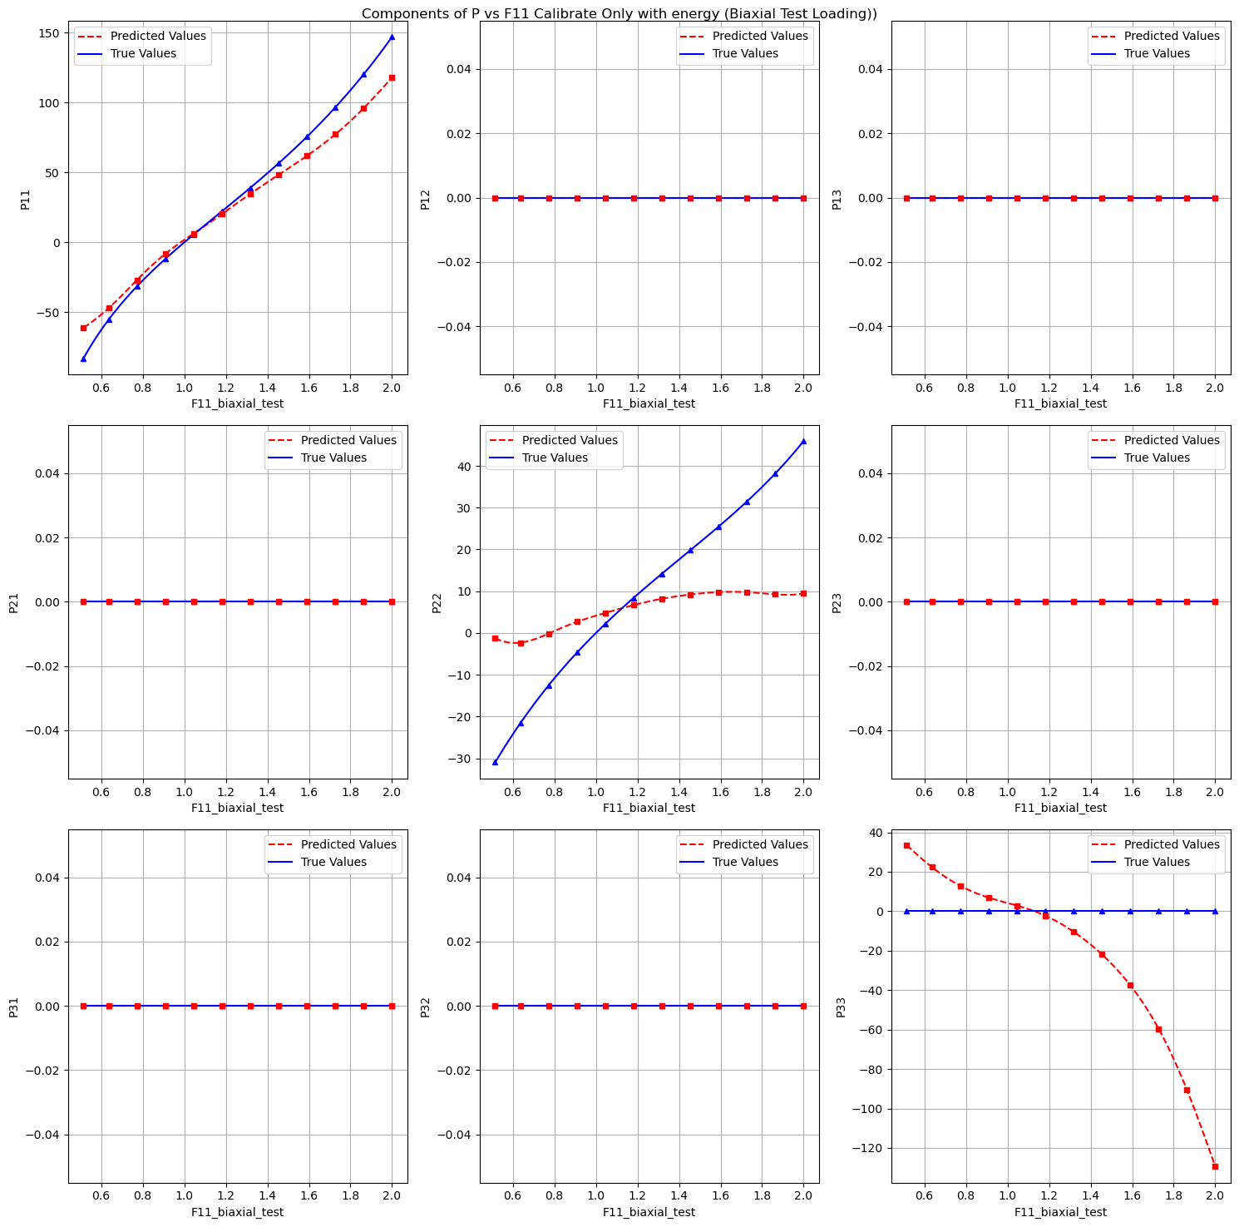
3.2 Model calibration
Components of P vs F11 Calibrate Only with Energy (Biaxial Test Loading):

Slide 19
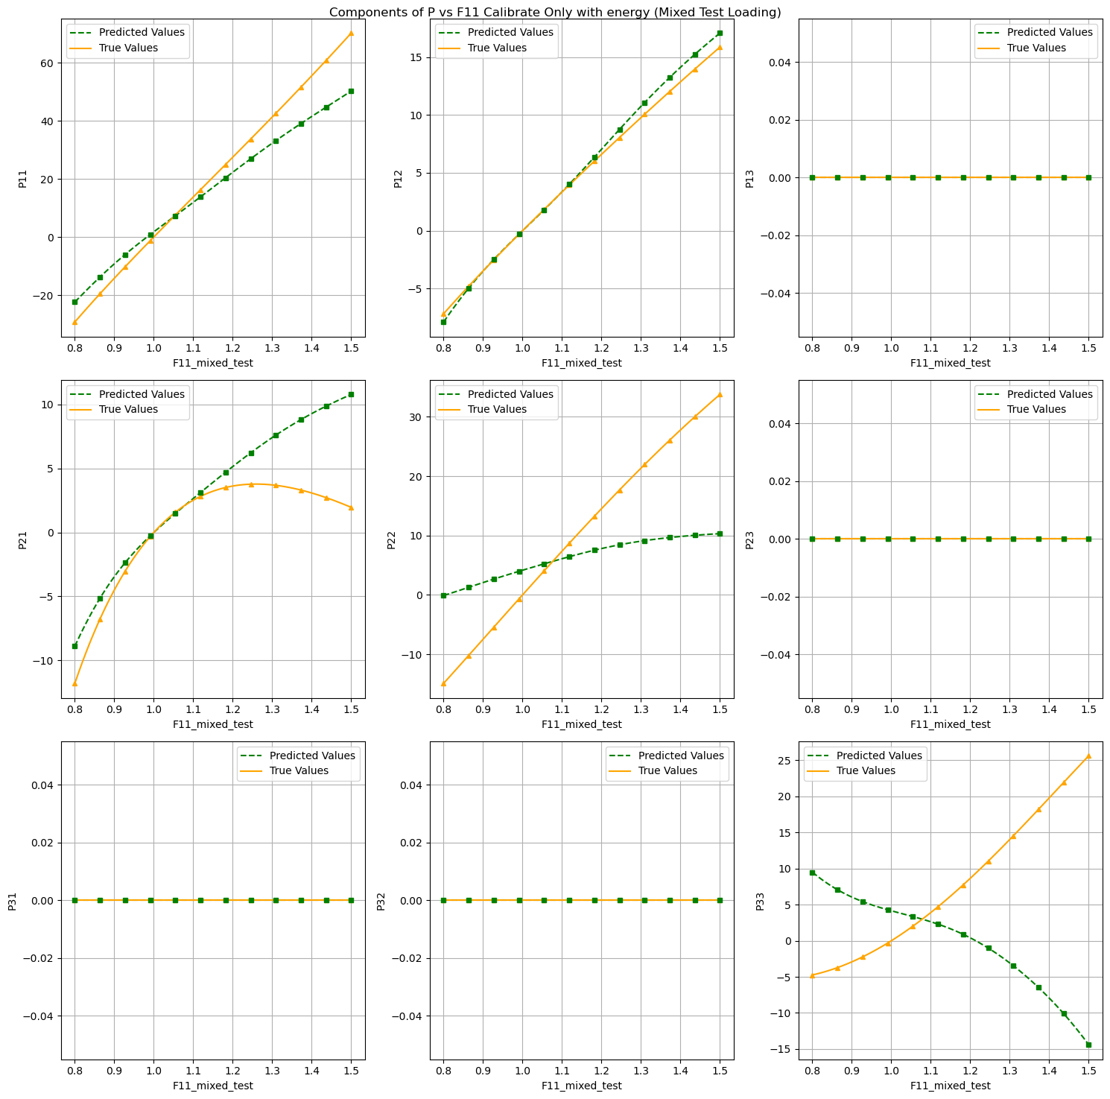
3.2 Model calibration
Components of P vs F11 Calibrate Only with Energy (Mixed Test Loading):

Slide 20
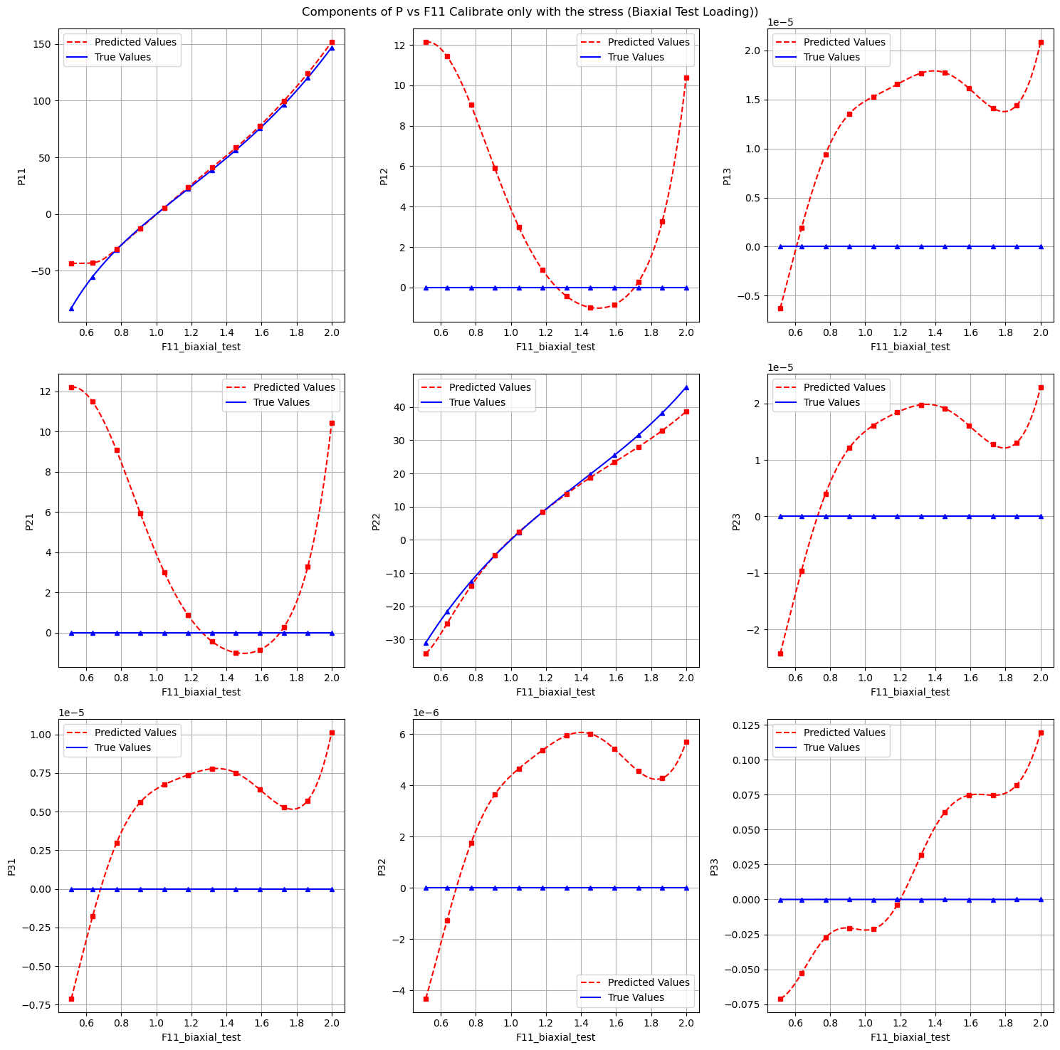
3.2 Model calibration
Components of P vs F11 Calibrate Only with Stress (Biaxial Test Loading):

Slide 21
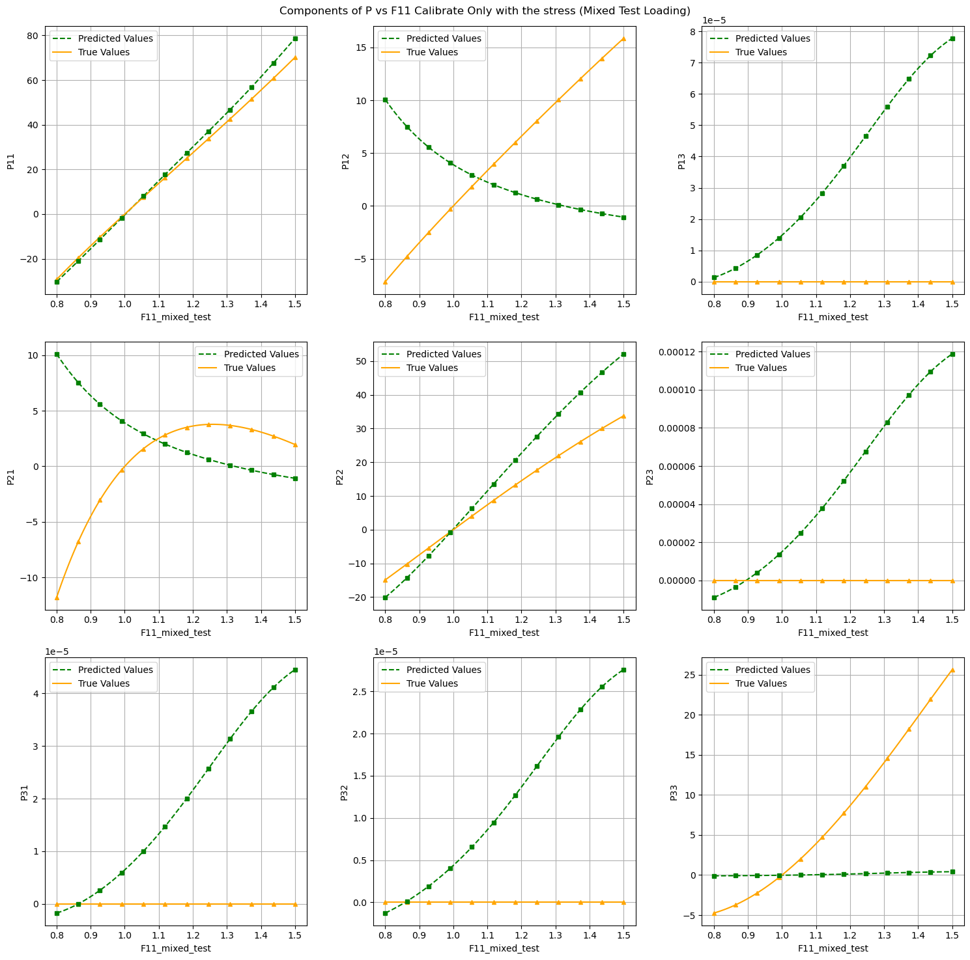
3.2 Model calibration
Components of P vs F11 Calibrate Only with Stress (Mixed Test Loading):

Slide 22
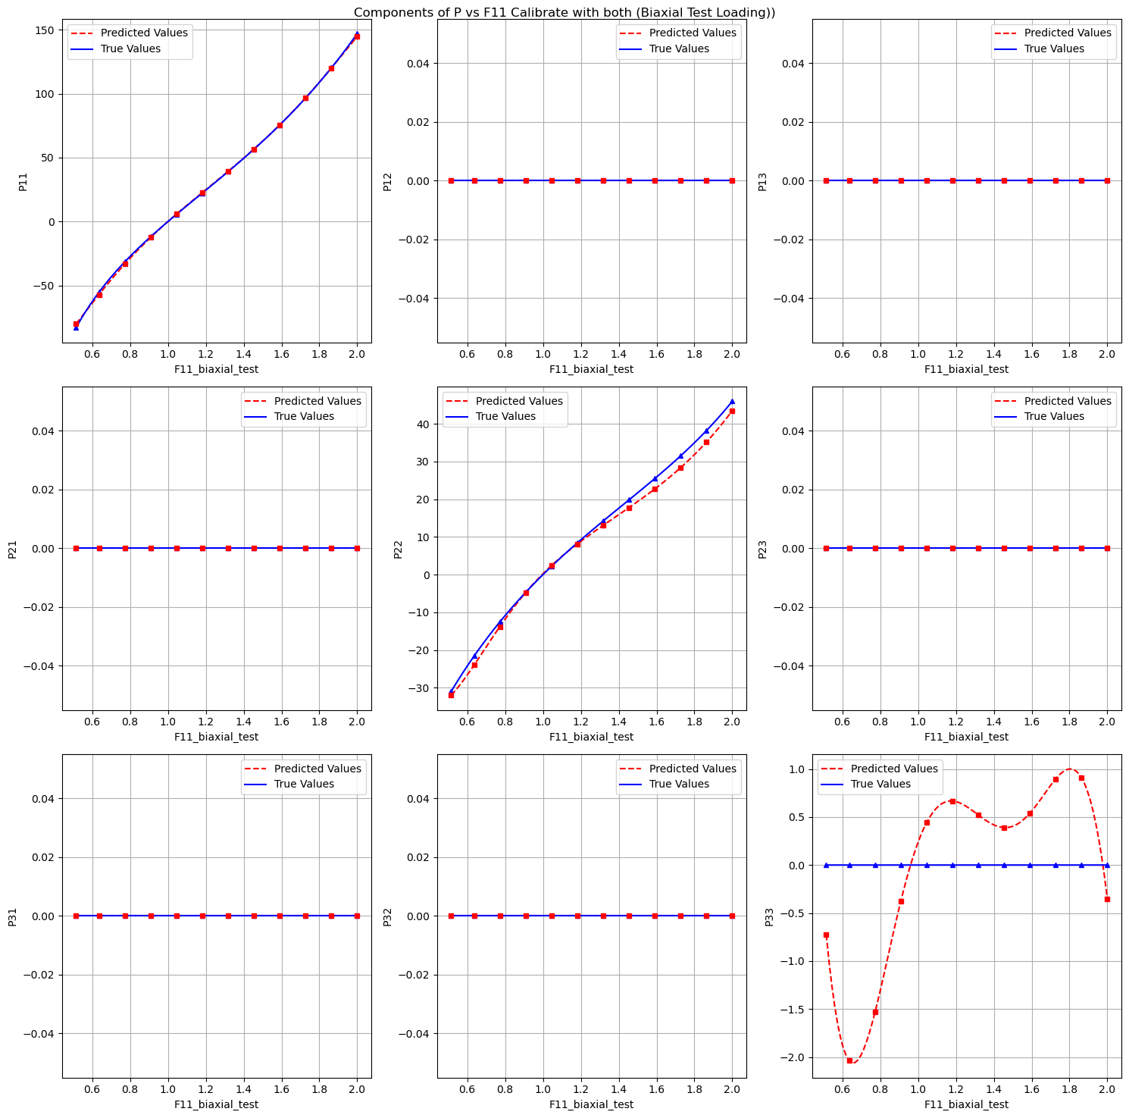
3.2 Model calibration
Components of P vs F11 Calibrate with Both (Biaxial Test Loading):

Slide 23
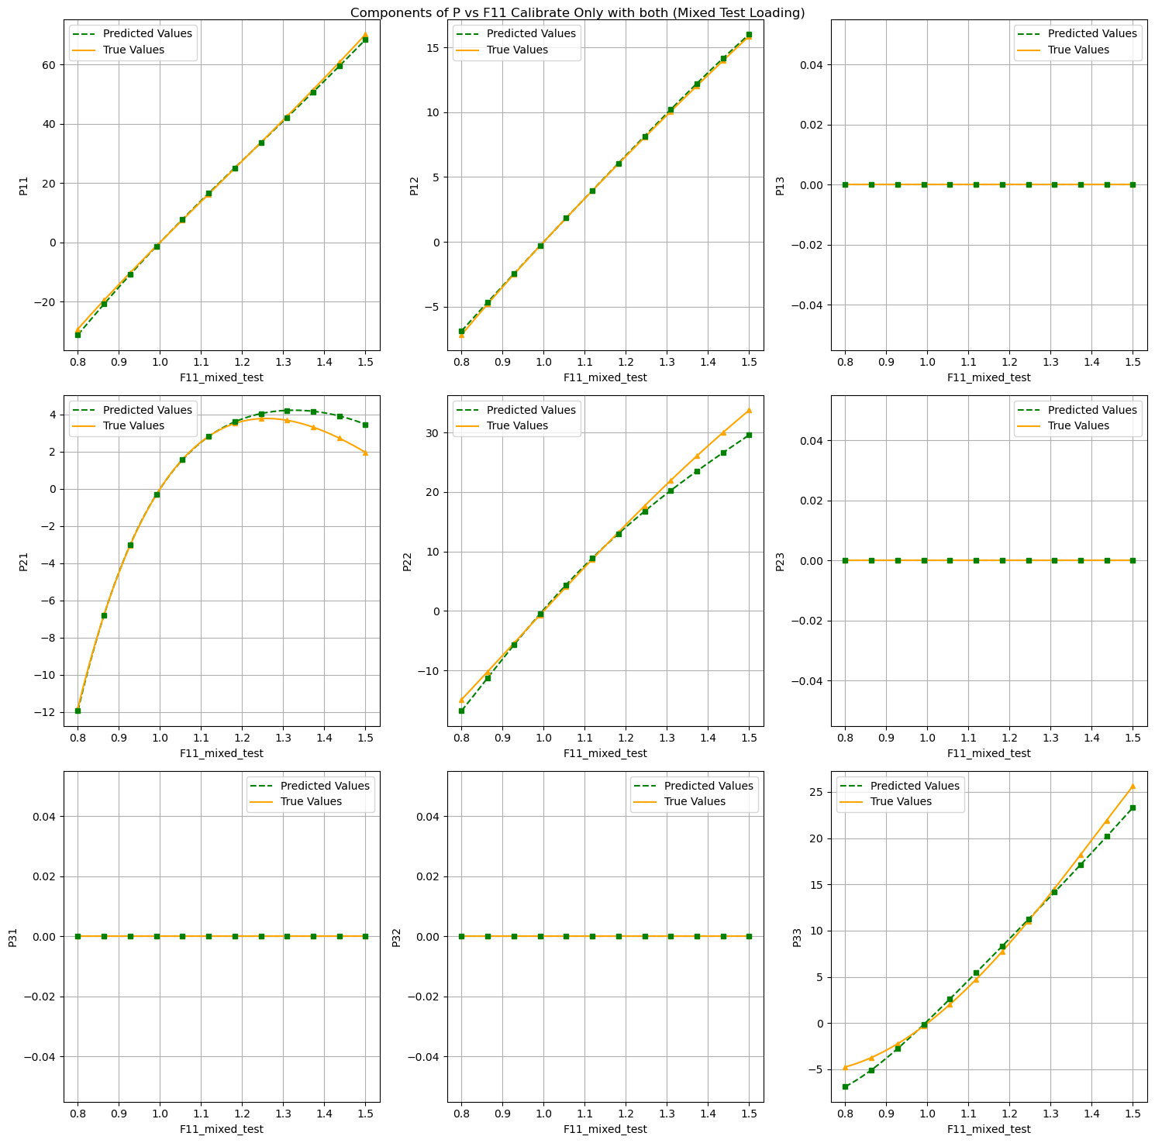
3.2 Model calibration
Components of P vs F11 Calibrate with Both (Mixed Test Loading):

Slide 24
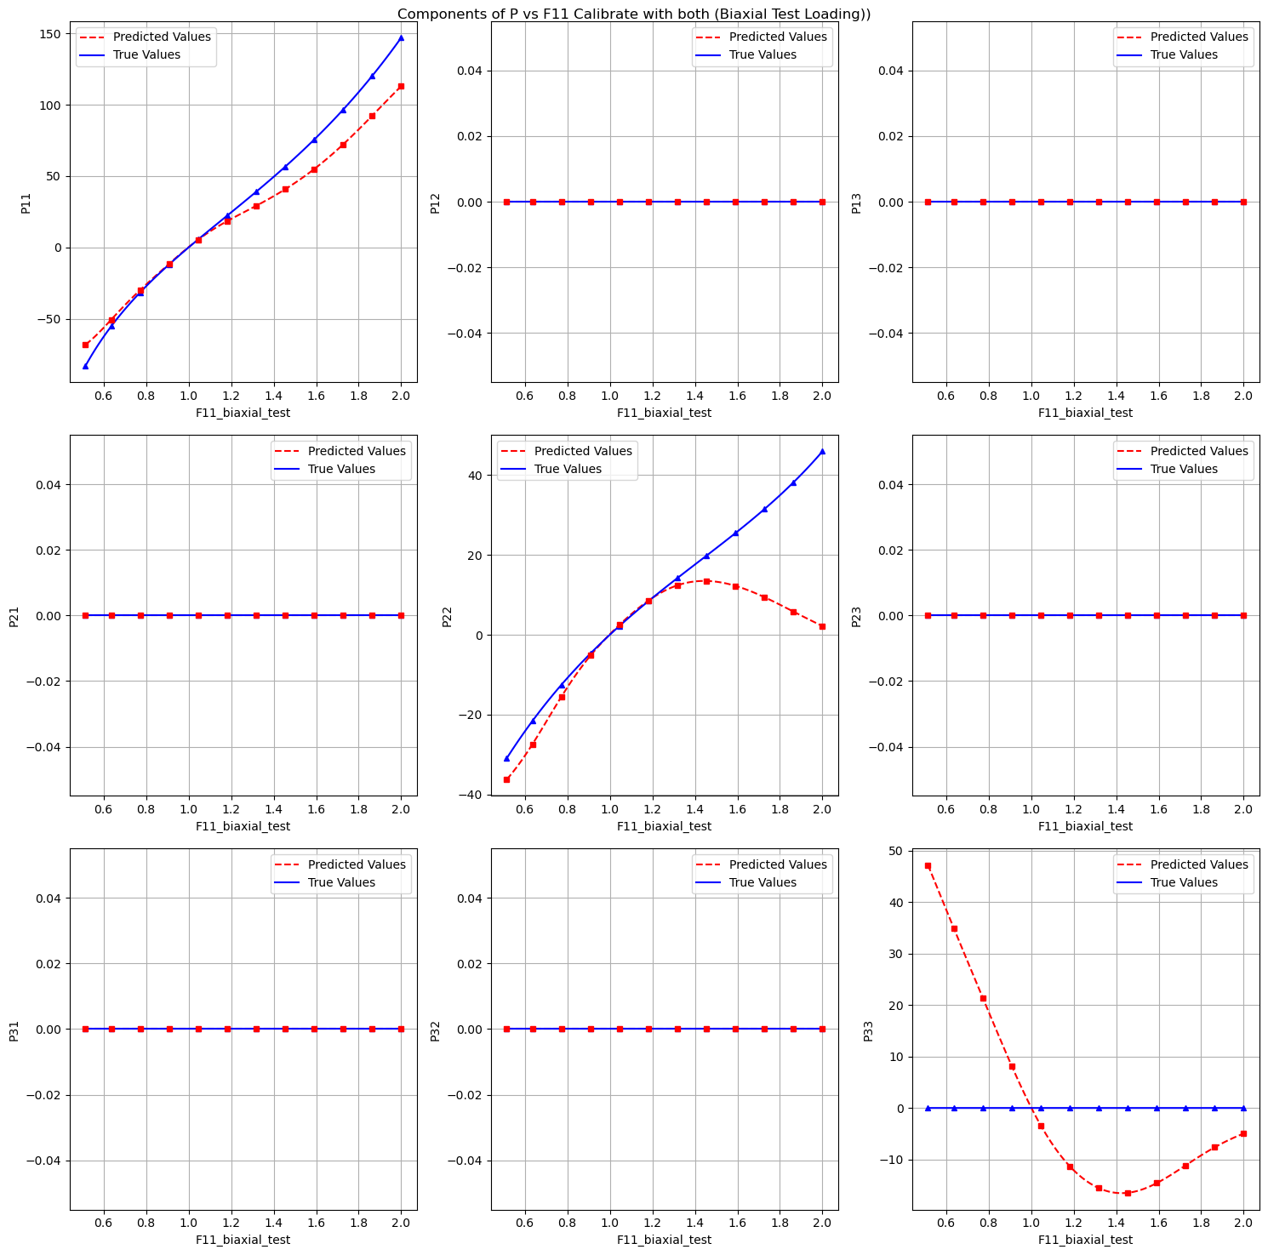
3.2 Model calibration
Components of P vs F11 Calibrate with only on uniaxial tension (Biaxial Test Loading):

Slide 25
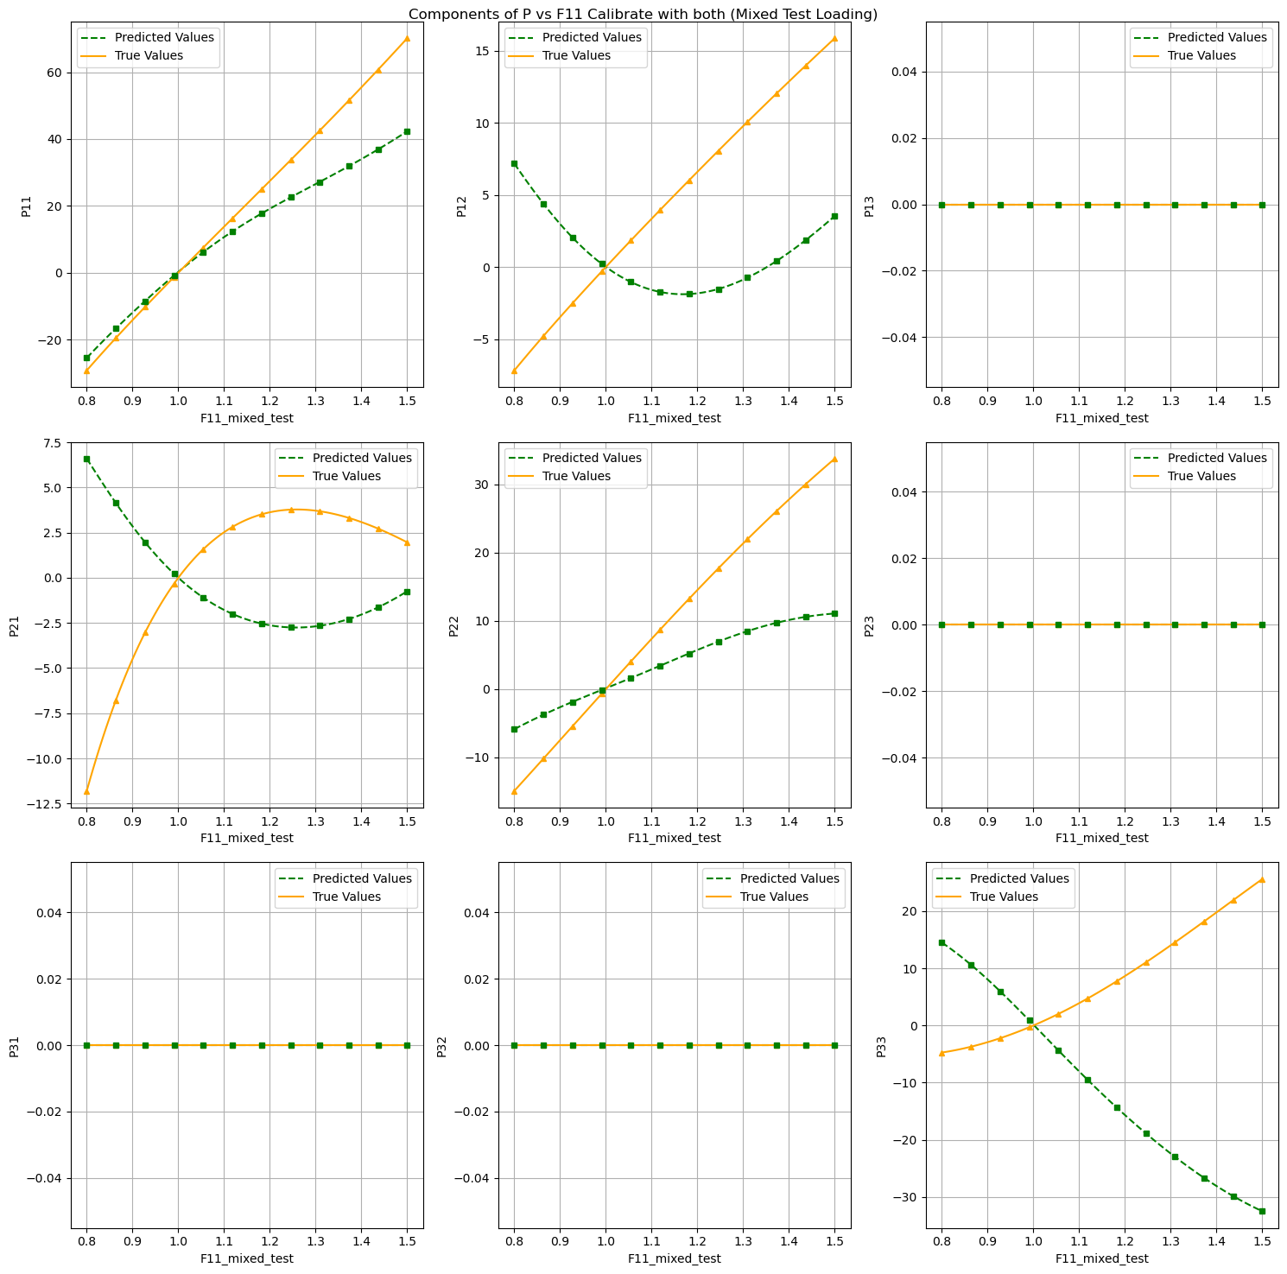
3.2 Model calibration
Components of P vs F11 Calibrate with both only on uniaxial tension (Mixed Test Loading):

Slide 26
3.2 Model calibration
1. Is the model able to interpolate the calibration dataset?
Yes
2. Is the model able to predict the unseen load cases of the test dataset?
Yes
3. Use different load paths for the calibration of the model, Is the model still able to extrapolate to the other cases?
No

Slide 27
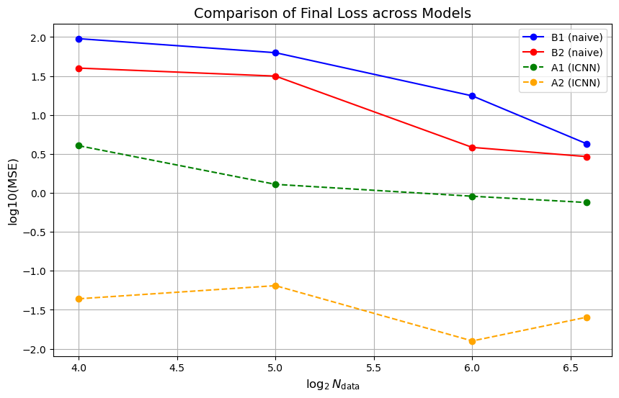
4. Concentric sampled deformation gradients
B1: naive model
2 hidden layer
(16,16)
B2: naive model
4 hidden layers
(64,64,64,64)
A1: PANN model
1 hidden layer
(8)
A2: PANN model
2 hidden layers
(16,16)
Notes:
For Chapter 4, our task is to evalutate the two models. So I choose 4 models to compare. B1 is a naïve model with 2 hidden layers and each layer contains 16 nodes. B2 is 4 hidden layers each with 64 nodes. A1 And A2 are ICNN model and only have 1 and 2 hidden layers with each 8 and 16 nodes.
From results we can see with the increase of data size, both model we can get a better accuracy. And the icnn models demonstrate better generalization ability and efficiency, especially in cases with smaller datasets.
But the naive models require more data and a more complex network structure to approach the performance of the ICNN models, and it still fall short. Maybe when we have enough data, the naive model will perform better than the icnn model.

Slide 28
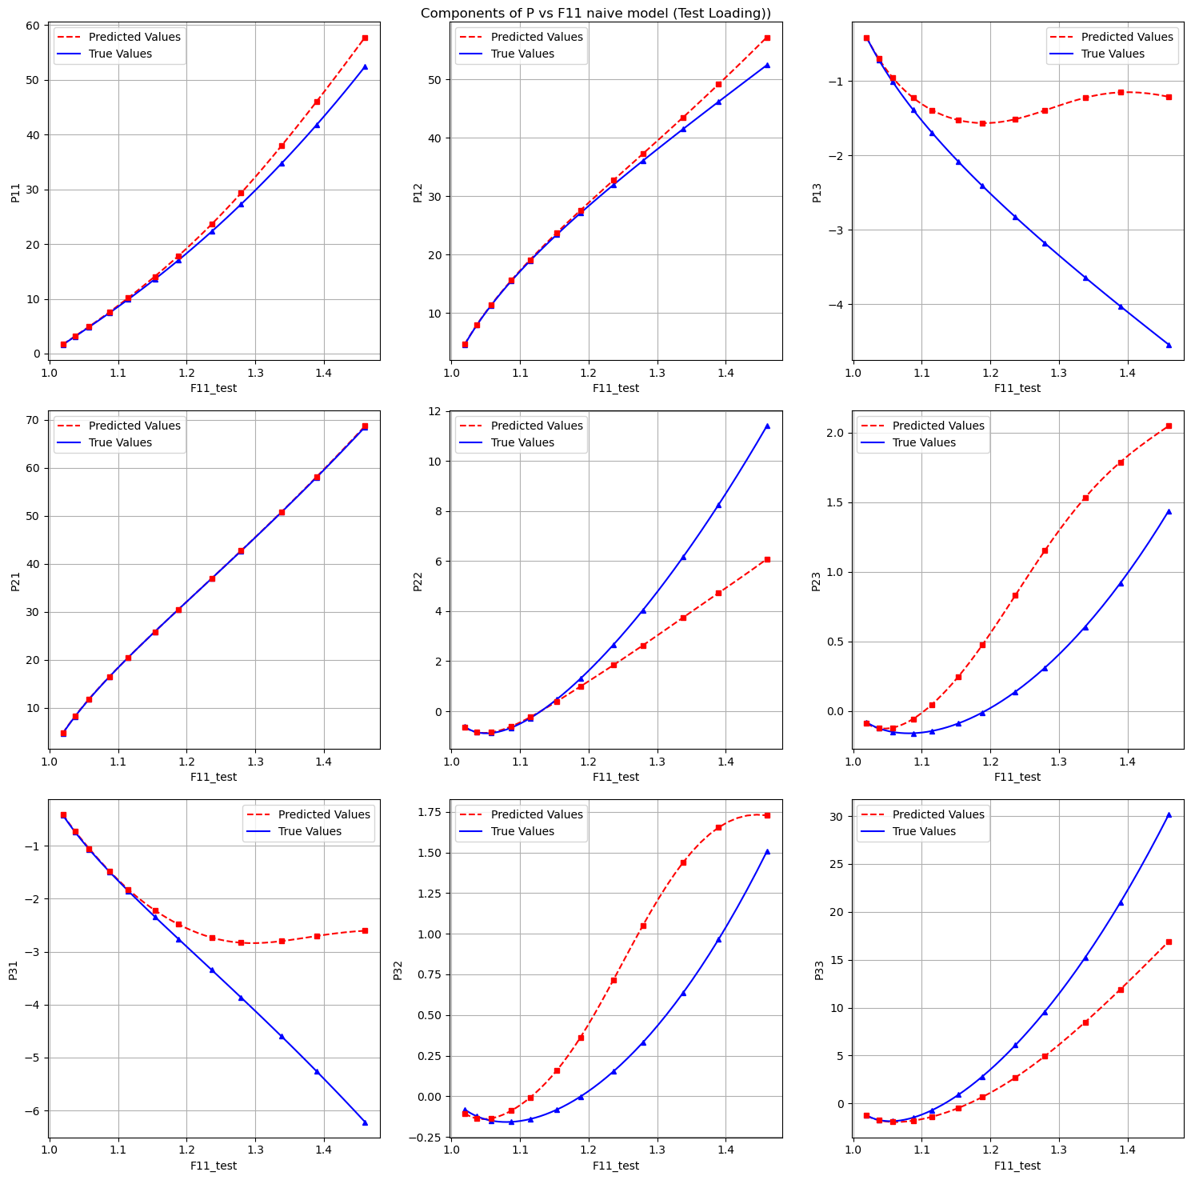
4. Concentric sampled deformation gradients
Components of P vs F11 Calibrate with B2 on 96 files (Test Loading):

Slide 29
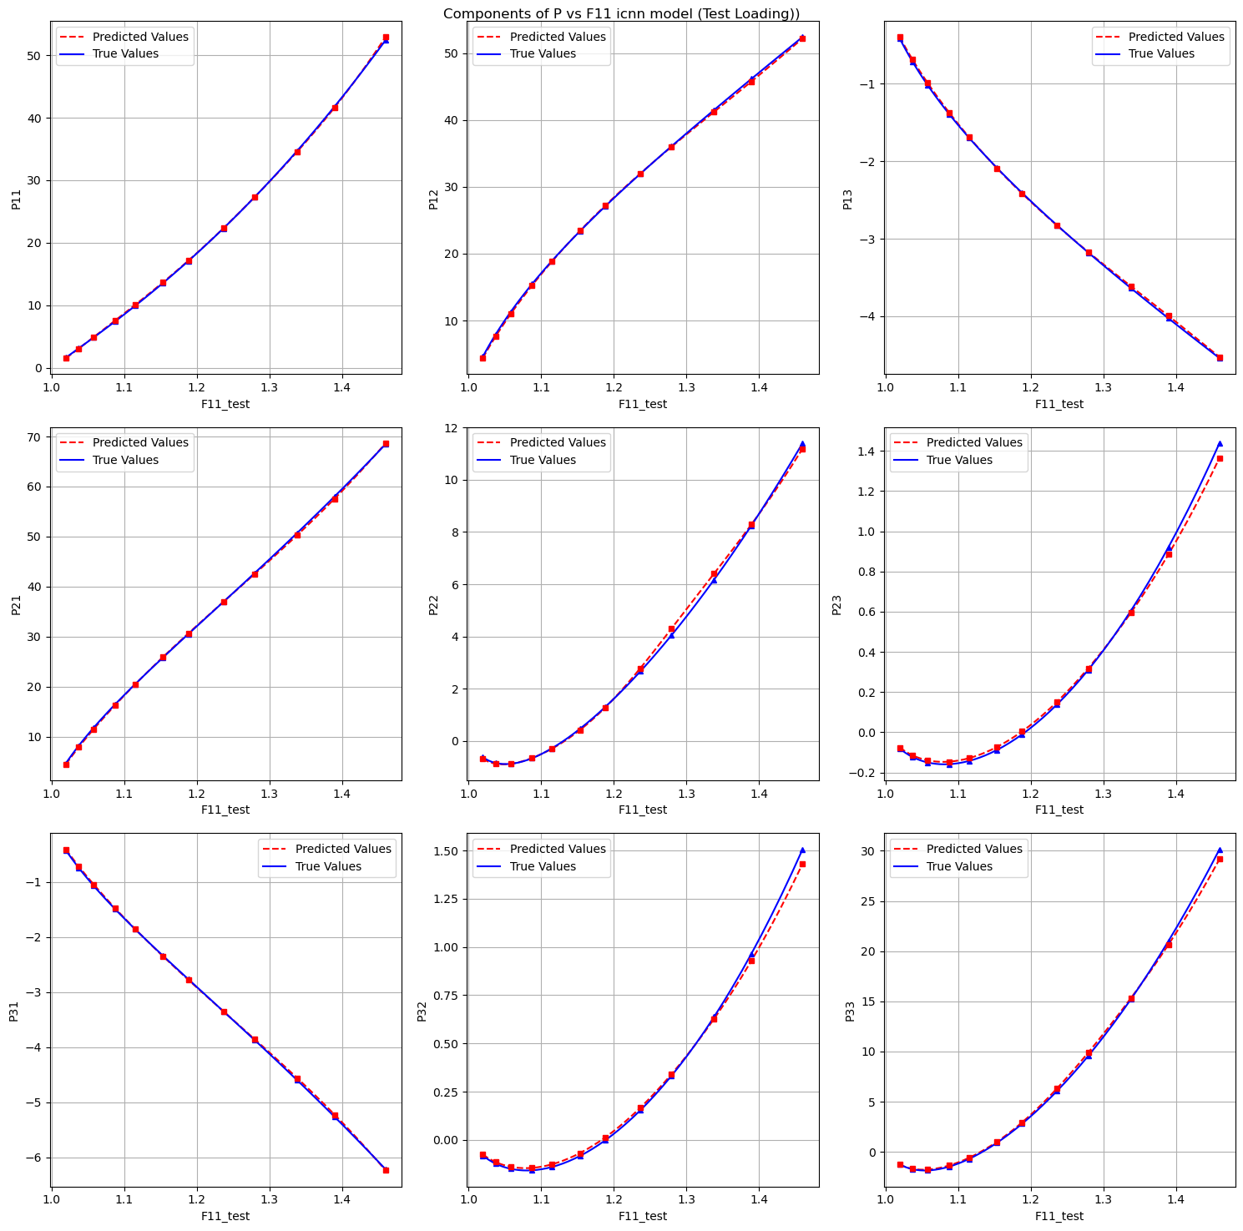
4. Concentric sampled deformation gradients
Components of P vs F11 Calibrate with A2 on 96 files (Test Loading):

Slide 30
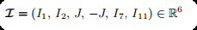
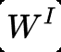
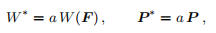
5.1 Data preparation
Introduction
input
output
optimizers
Notes:
For chapter 5, we change a little from model in Chapter 3. because it's cubic lattice materials, so we have to change the defination of invariants.
Here very important is we can scale the output both W and P. It would imporove numerical stability and make it a faster convergence.
the reason why we can't use Batch Normalization. Is that would shift the inputs and violates the physical constraints and mathematical structure of the model.

Slide 31
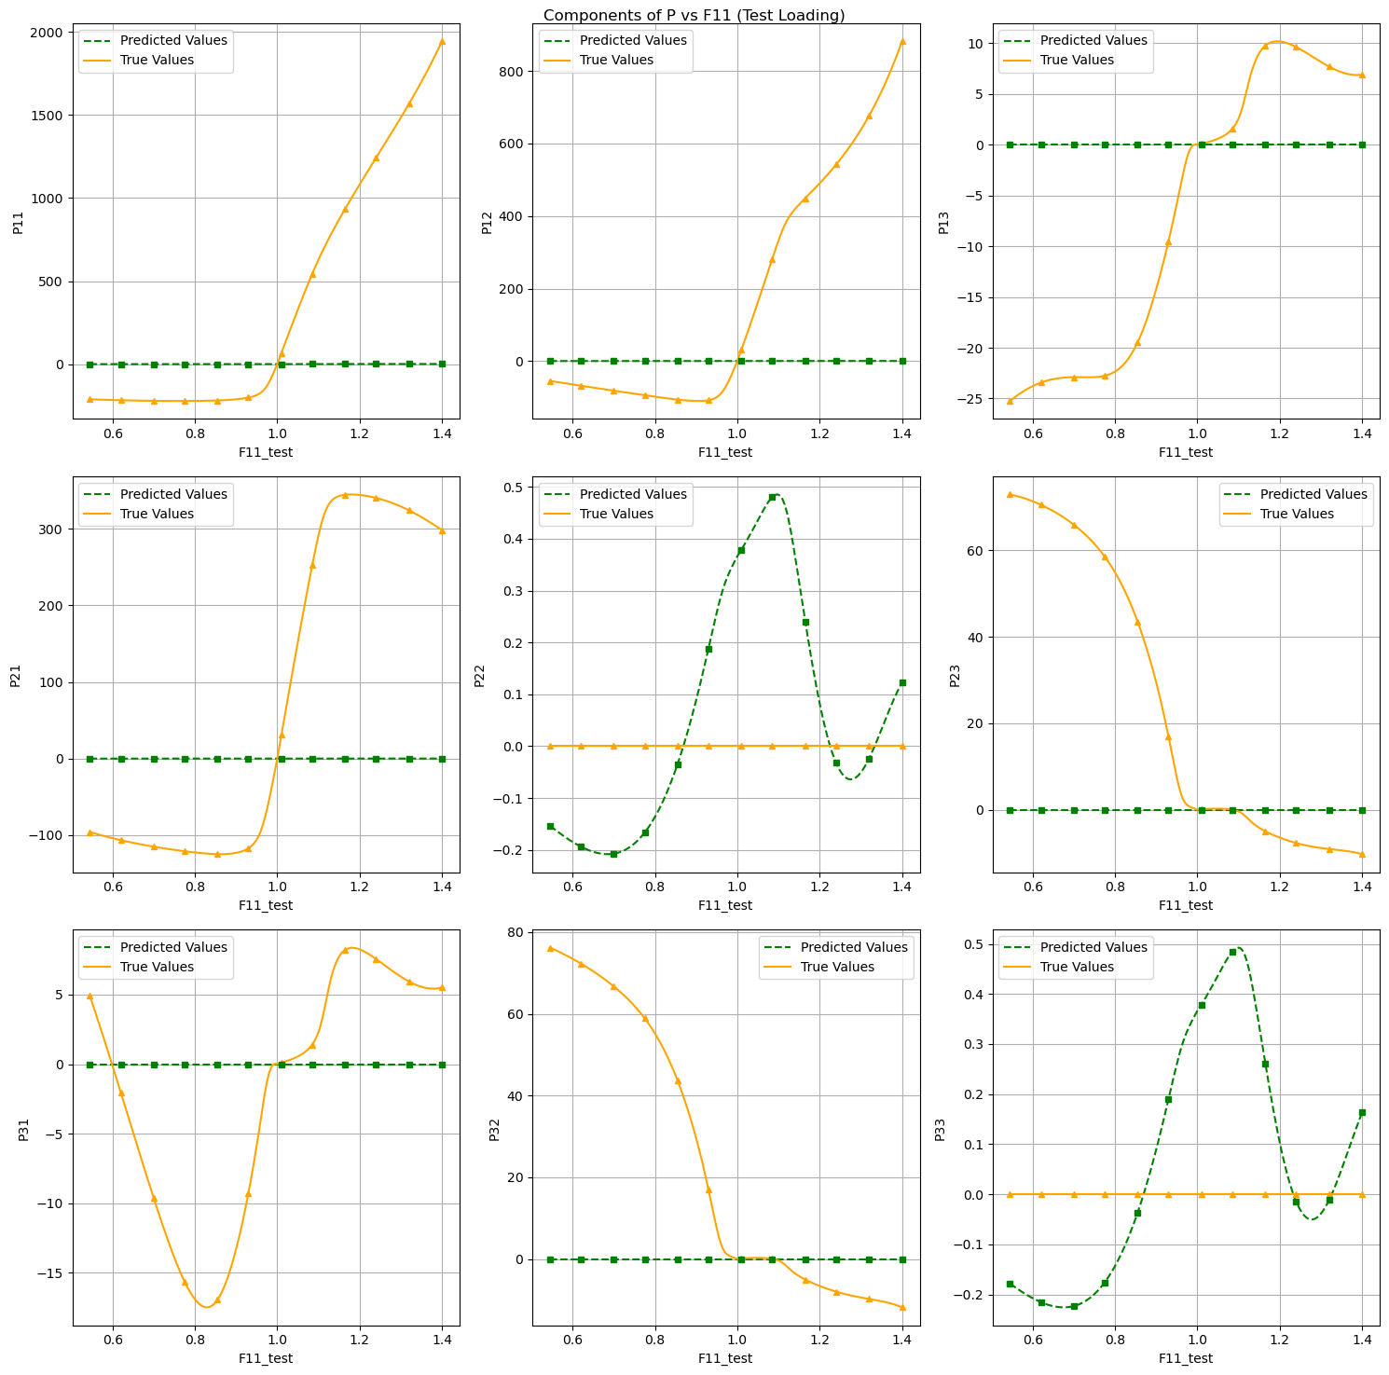
5.2 Invariant-based model
Notes:
We can see for this model, for the test set, particularly in cases with complex loading paths (such as mixed tension-shear), the model's extrapolation capability may be limited because the invariant inputs lose some critical information about the deformation. The complex behavior of shear deformation may result in the model being unable to fully capture this scenario.

Slide 32
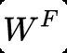
5.1 Deformation-gradient based neural network model
Introduction
input
output

Slide 33
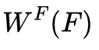
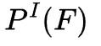
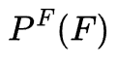
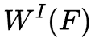
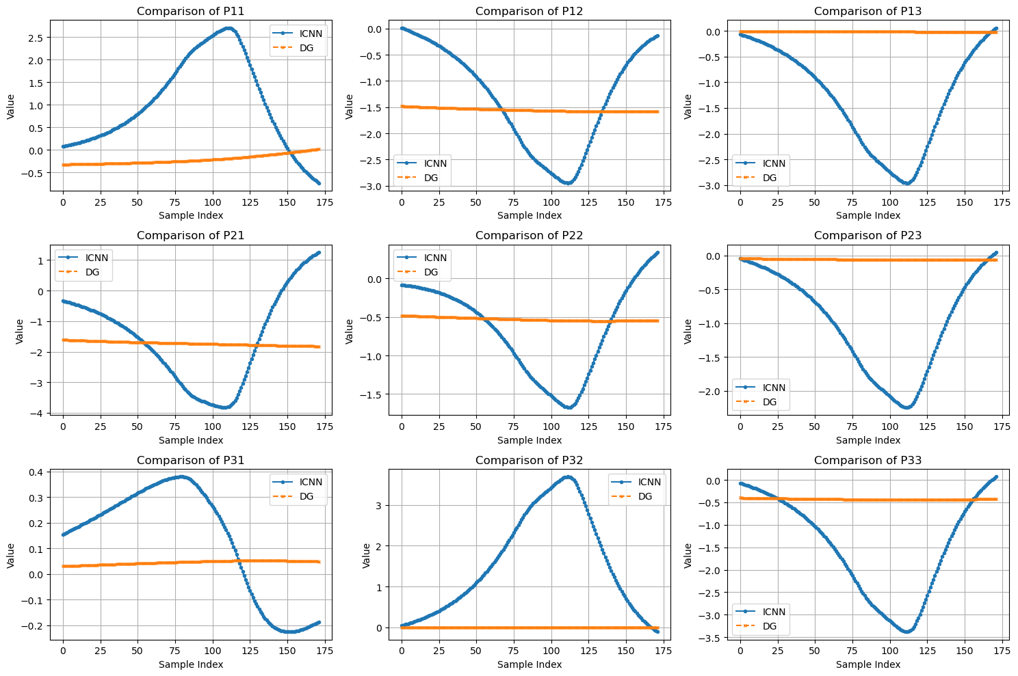
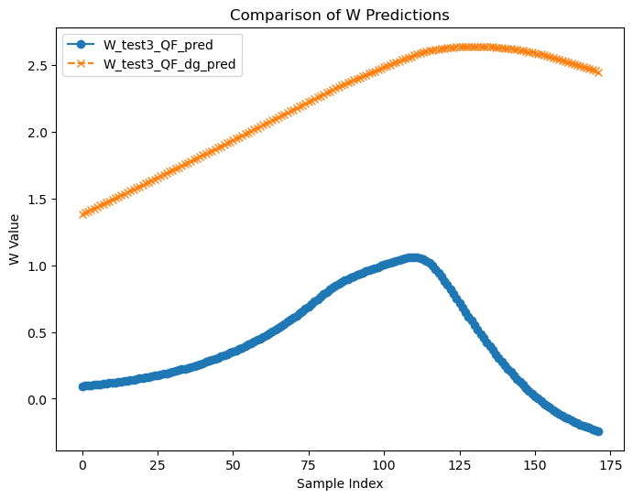
5.3 evaluate the invariance condition
?
?
Notes:
While this model satisfies polyconvexity, we want to know if it also satisfies objectivity condition. So we compare with the ICNN model, because icnn model satisfies objectivity condition in nature. Unfortunately from the results we can say it don't satisfy the objectivity condition.

Slide 34
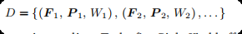
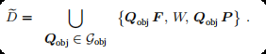
5.4 Data augmentation
Notes:
To address this issue, we introduce data augmentation. The key idea is to artificially expand the dataset by applying random rotations Q to the deformation gradient and stress tensors. Data augmentation increases data diversity and improves the model's ability to generalize under various loading and observation scenarios.

Slide 35
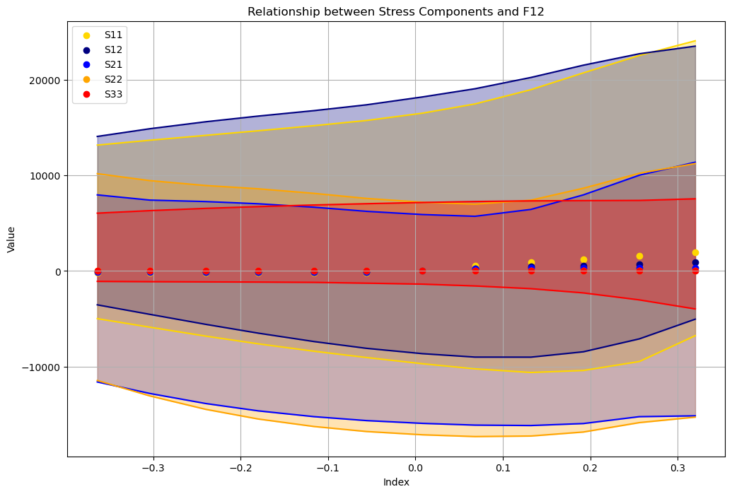
5.4 Data augmentation
8 observer
Notes:
In the following, the model 𝑊 F is calibrated using 8 observers, and all evaluations for the model are carried out with 1,024 random observers

Slide 36
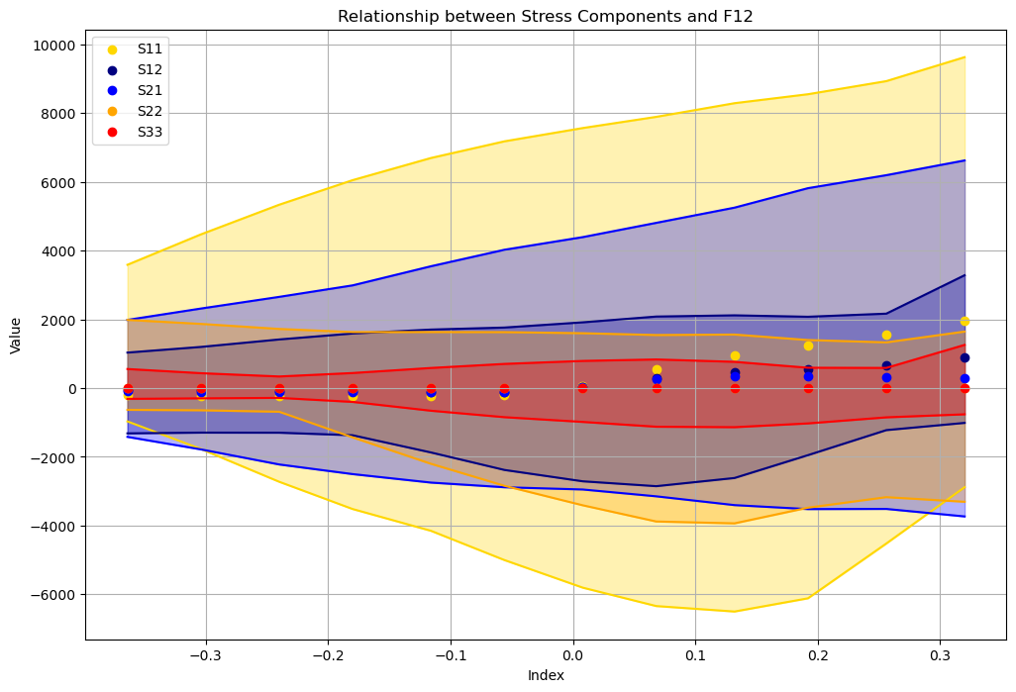
5.4 Data augmentation
16 observer
Notes:
Using more observers for the data augmentation, the approximation quality of the objectivity increases.

Slide 37
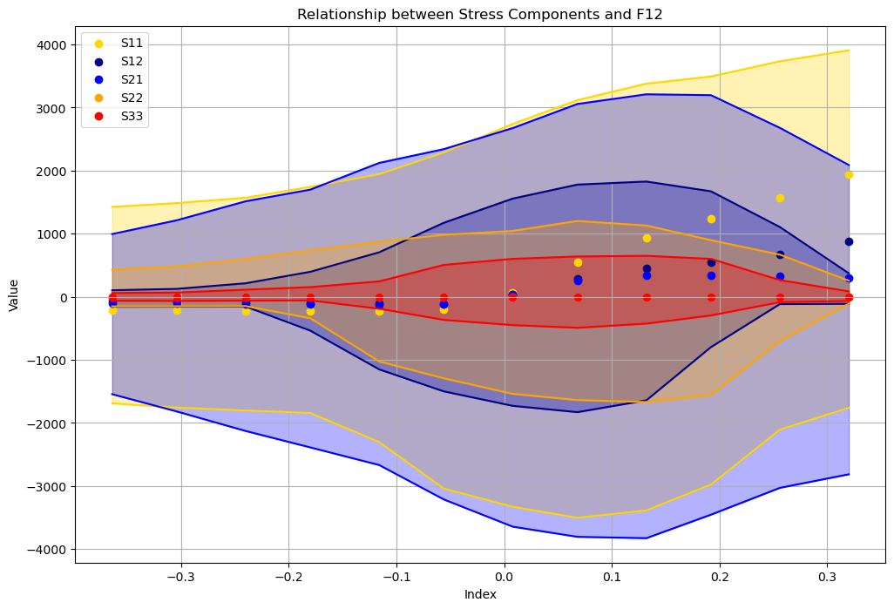
5.4 Data augmentation
32 observer

Slide 38
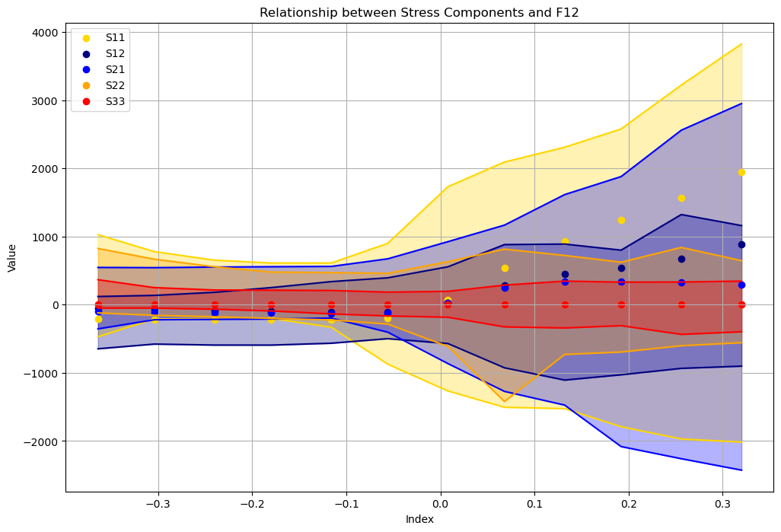
5.4 Data augmentation
64 observer
Notes:
In the following, the model 𝑊 F is calibrated using 8 observers, and all evaluations for the model are carried out with 1,024 random observers

Slide 39
Danke
Xin Xiong, Huasen Luo

